Slide 1

A/B TESTING EVALUATION- VANGUARD UX REDESIGN
Does the new design better user completion?
Ewakise, Dei and Felix
May 2025

Slide 2
CONTENT TABLE
Introduction.
Data Overview.
Exploratory Data Analysis. (EDA)
Tableau Visualizations
Performance metrics.
Hypothesis Testing :
Completion Rate Improvement.
Demographic Diferences.
Error & Funnel Drop-Off Analysis.
Experiment Evaluation.
Teamwork & Project Management.
Challenges & Learnings.
Conclusion.
Next Steps.
Thank you.

Slide 3

01
INTRODUCTION
Vanguard introduced a redesigned user interface aiming to increase user completion in the digital onboarding process.
Main Question: Does the new UI lead to higher completion rates compared to the old version?

Slide 4

DATA OVERVIEW
02
Datasets Used:
Client Profiles (df_demo)
Experiment Group Assignment (df_experiment)
Web Interactions (df_web)
Vous pouvez donner ici une brève description du sujet dont vous souhaitez parler. Par exemple, si vous voulez parler de Mercure, vous pouvez dire que c'est la plus petite planète de tout le système solaire
Data Cleaning & Merging:
Removed rows with missing age and tenure.
Standardized gender labels (M/F)
Merged datasets by client_id
Parsed process_step sequences and formatted date_time

Slide 5
“ Design is not just what it looks like and feels like. Design is how it work. ”
—Steve Jobs

Slide 6
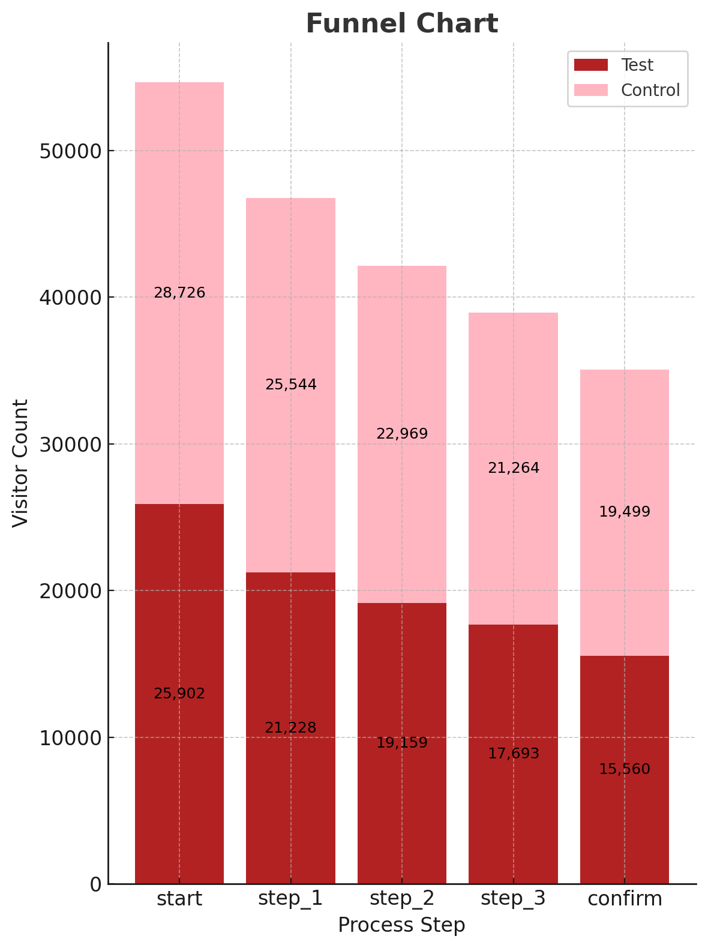
EXPLORATORY DATA ANALYSIS (EDA)
03
Visualizing user progression through the onboarding process
Test group (new UI) retains more users at every stage
Major drop-off at Step 2 for the Control group
Test group improves mid-funnel retention by up to +8%
Indicates clearer guidance and better step continuity in new design

Slide 7
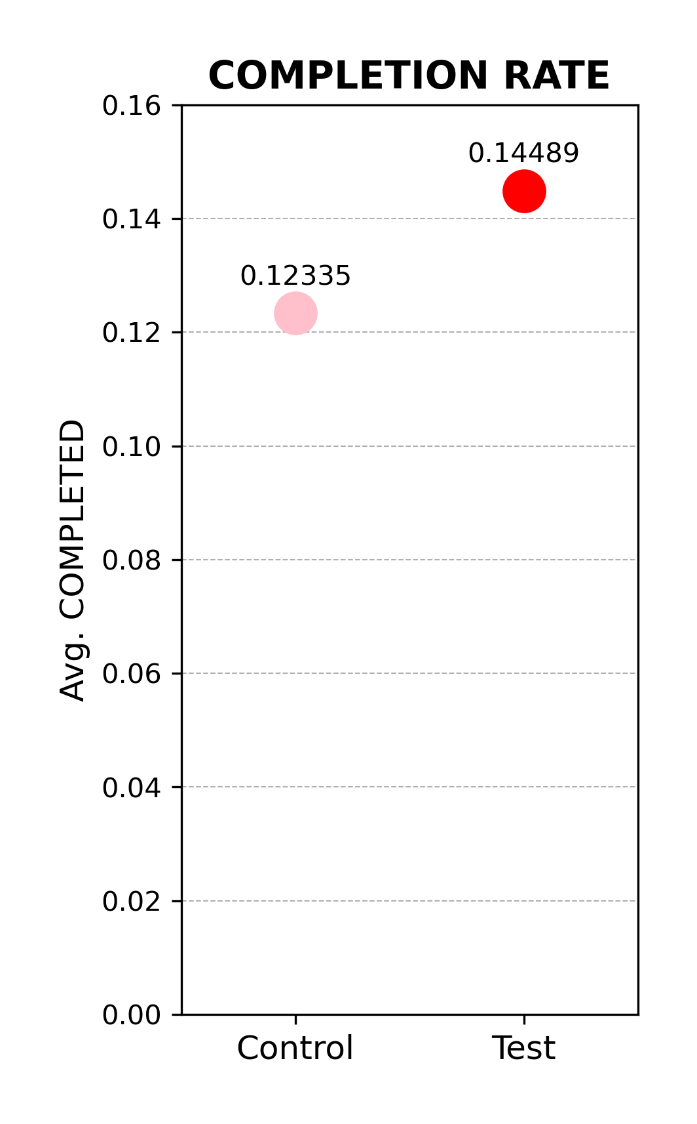
EXPLORATORY DATA ANALYSIS (EDA)
03
Completion measured as % of users reaching the final step (confirm)
Test group: 14.5% average completion
Control group: 12.3% average completion
+2.2 percentage point improvement with new UI
Indicates positive impact, but smaller than expected
May be influenced by increased navigation confusion

Slide 8
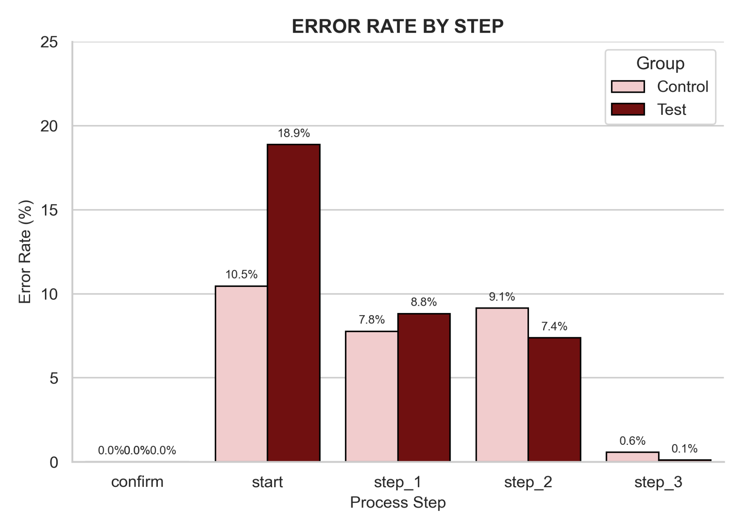
EXPLORATORY DATA ANALYSIS (EDA)
03
Visualizes % of users who navigated backward or repeated steps
Test group shows higher error rates at most steps, particularly:
Start: 18.88% (Test) vs 10.46% (Control)
Step 2: 7.38% (Test) vs 9.14% (Control) — only step where Test performed slightly better
Largest gap at the Start step → suggests initial confusion with new UI
Near-zero error rate at final step ("confirm") for both groups
Indicates that the new UI introduced early-stage uncertainty, despite improving overall flow

Slide 9
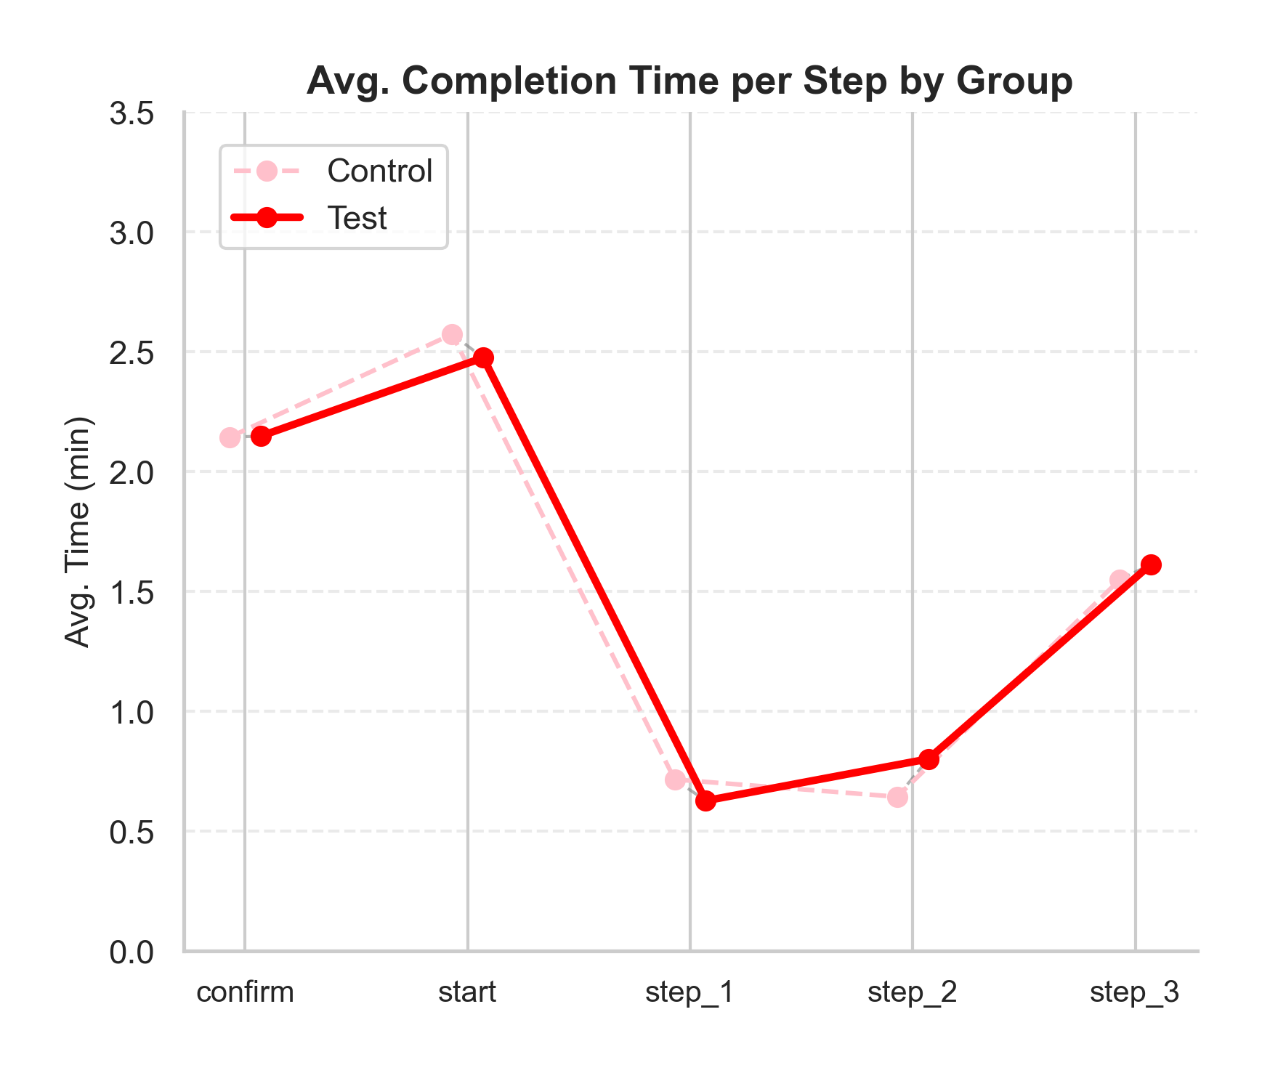
EXPLORATORY DATA ANALYSIS (EDA)
03
Step 1 and Step 2 show the most time savings for the Test group
Step 1: Test users were 12% faster
Test group took longer at Step 3 (1.61 vs 1.55 min)
Suggests users needed more time to confirm choices
Overall, Test group was slightly faster across most steps, indicating smoother flow
Vertical dotted lines show per-step performance difference visually
Differences are small but consistent, favoring the redesigned UI

Slide 10
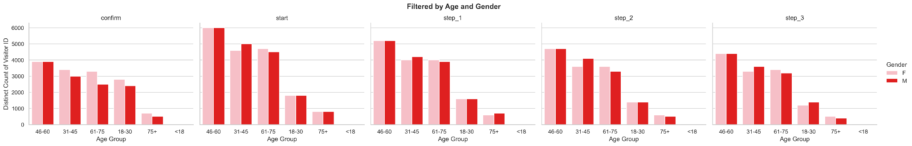
EXPLORATORY DATA ANALYSIS (EDA)
03
Consistent improvement across gender and tenure
Strongest gains in age group 40–60
Indicates the new UI helps less tech-savvy users most
No major variation across other segments

Slide 11
TABLEAU VISUALIZATIONS
{LINK DASHBOARD}
04

Slide 12
PERFORMANCE METRICS
05
Key KPI: Completion RAte = % of users who reached confirm step
Test group: 69,29%
Control Group: 65,59%
Difference: 3,71%
Statistical Result:
Statistically significant (p-value: 3.5e-19), but…
Not cost-effective (threshold was 5%)

Slide 13
Hypothesis Test
06
5.1 Completion Rate Test
Z-test confirms statistically significant improvement
P-Value < 0.05 H₀
But not cost-effective (treshold unmet)
 | 5.2 Demographic Balance
 | Age: significant difference (p = 0.016)
 | Tenure: significant difference ((p = 0.086))
 | Gender: no difference (p = 0.24)
 | 5.3 Error & Drop-Off Analysis
 | Error rate:
 | Test: 26.76%
 | Control: 20.23%

Slide 14
50,000+
Total users included in the A/B test.

Slide 15

EXPERIMENT EVALUATION
07
Design: Randomized controlled A/B test.
Duration:
Limitations
Slight age imbalance.
Higher navigation errors in Test group.
No tracking by platform (mobile vs desktop)

Slide 16

TEAMWORK & PROJECT MANAGEMENT
08
TRELLO
GitHub
for tracking
to manage notebook & code
CHECK-INS
TABLEAU
frequent sync meetings for EDA & testing
dashboard built collaboratively to share key insights

Slide 17
CHALLENGES & LEARNING
01
02
03
04
09
DATA INTEGRATION
FUNNEL ANALYSIS
Merged datasets had inconsistent ID formats
Step-by-step view revealed key drop-offs
USER BEHAVIOR & UX
INSIGHTS VS. BLUSINESS VALUE
Backward steps exposed UX friction
Statistical win didn´t meet busines threshold

Slide 18
CONCLUSIONS & RECOMMENDATION
10
COMPLETION RATE INCREASED
NOT COST-EFFECTIVE
UX ISSUE DETECTED
Test group performed better — 14.5% vs 12.3%
Didn’t reach the 5% business impact threshold.
High error rate (18.88%) at Start step → user confusion.
💡 Recommendations:
Refine early steps → reduce confusion
Collect user feedback
Re-run A/B test after improvements
Track performance by device

Slide 19

11
NEXT STEPS
Finalize UI adjustments based on early funnel insights.
Launch a new test version after applying usability fixes.
Prioritize mobile/desktop segmentation and age-based behavior.
Run targeted user tests to uncover friction points.

Slide 20
THANK YOU
“Data doesn’t speak— it whispers. It’s your job to listen.”
Unknown
12

